Slide 1
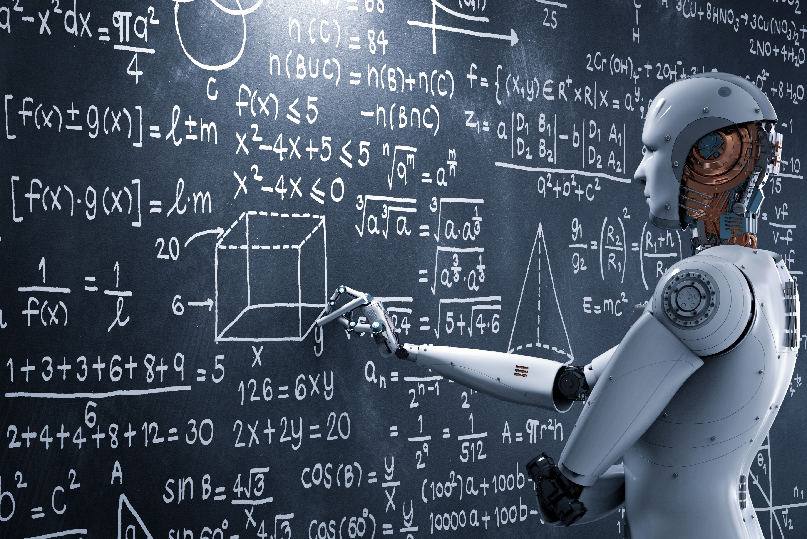

What is deep learning & deep neural networks
Dr. Marius Terblanche Clinical Consultant in Critical Care Medicine, Guy’s & St. Thomas’ NHS Foundation Trust, London, UK Chair, TAHI Working Group, ESICM
@mterblance2 @GSTTnhs

Slide 2

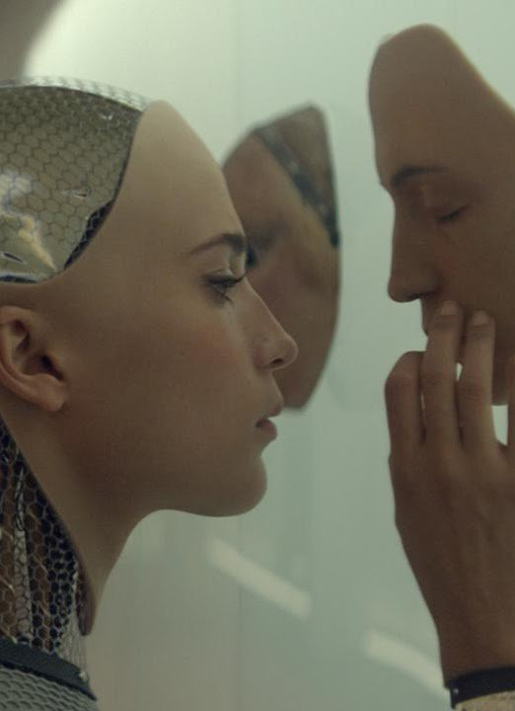
Conflict of interest statement
Founder:
ideation.AI Ltd
Part-time senior associate:
Deloitte Healthcare
Tech geek
All views are my own

Slide 3
Technology likely to transform healthcare beyond 2017
http://blogs.deloitte.co.uk/health/2017/01/12-medical-technology-innovations-likely-to-transform-healthcare-in-2017.html
3D printing
3D visualisation & AR
AI, predictive analytics & machine learning
Blockchain
Diabetes drugs & advanced monitoring
Drone technology
Gamification
Liquid biopsies in cancer detection
Microbiomes
POC diagnostics
Robotics (surgical, rehabilitation & hospital)
Adoption of telemedicine

Slide 4
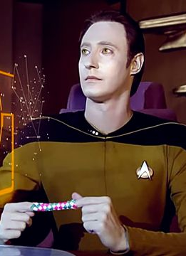
Discussion points
A brief introduction of deep learning & what goes on under the bonnet
Time-series data
Computer vision

Slide 5
Deep learning in critical illness is here

Slide 6
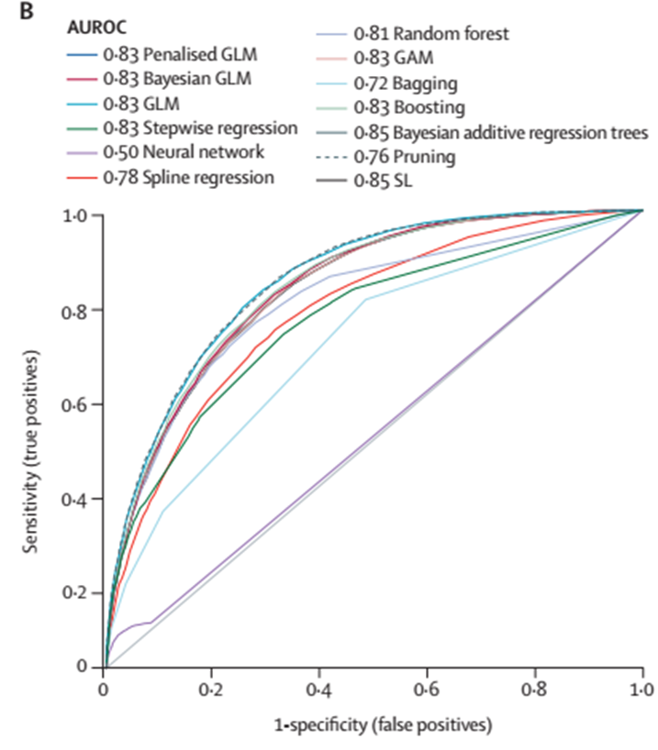
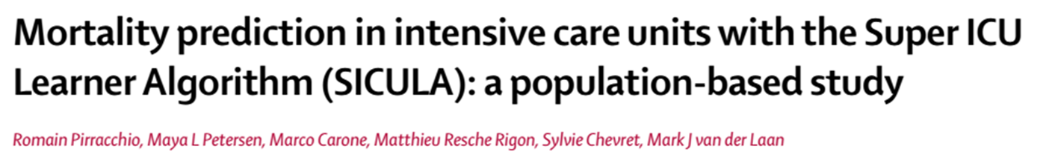


Slide 7
AI – machine learning – deep learning
Deep learning
Representation learning (e.g. shallow autoencoders)
Machine learning (e.g. logistic regression)
Artificial intelligence
From: Deep Learning – Goodfellow, Bengio and Courville. MIT Press 2016.

Slide 8
Artificial intelligence disciplines
Rule-based systems
Classic machine learning
Input
Hand- designed programme
Output
Input
Hand- designed features
Mapping from features
Output
Representation learning
Input
Features
Mapping from features
Output
Input
Simple features
Additional layers of more abstract features
Mapping from features
Output

Slide 9
Types of problems DNN can solve
Clustering | Unsupervised clustering
Regression | Network outputs a number based on input
Classification | Network classify data points into predefined classes
Prediction | Network predicts events in time
Optimisation | Network finds the best ordering or set of values to achieve an objective
Robotics | Using sensors and motor controls
Vision | Network understands images

Slide 10

How does a deep neural network work?
https://xkcd.com/1838/

Slide 11
Data considerations
Supervised
Unsupervised
Reinforcement learning
Uses labelled training datasets
Input (X) and output (Y) variables available
LEARN FUNCTION Y=F(X)
(Semi-supervised learning)
Examples
Regression
Classification
Etc.
Unlabelled training datasets
Only input (X) variable available
LEARN DATA STRUCTURE
Examples
Clustering
Dimensionality reduction
Agent receive information from the environment
Learn to choose actions that will achieve some reward
Example
Google DeepMind’s Go player

Slide 12
How does a (supervised) DNN algorithm work?
Learn a target function (f) that best maps input variables (x) to an output variable (y)
f:
Not interested in shape or form
Only want to know if it is making accurate predictions
Form estimated from available data
Y = f(X)

Slide 13
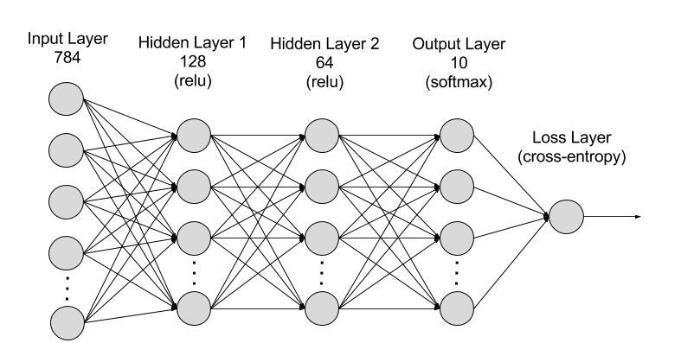
https://aws.amazon.com/blogs/machine-learning/introducing-gluon-an-easy-to-use-programming-interface-for-flexible-deep-learning/

Slide 14
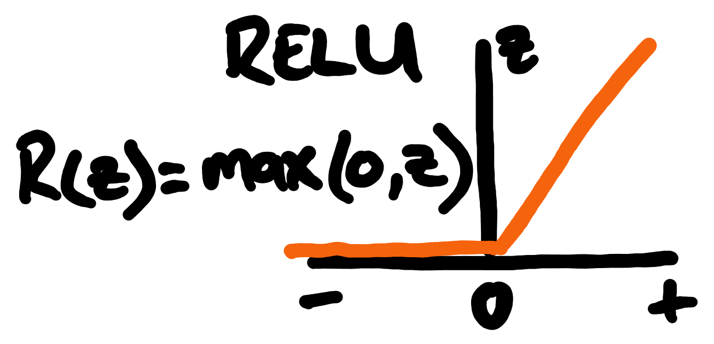
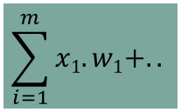
Repeated computational heavy lifting & weight adjustment inside each ‘neuron’…
Inputs
Weights
X₁
W₁
Activation function
Neuron
X₂
W₁
$$\sum_{i=1}^{m}{x1.w1+..}$$
Nett input
Output
X₃
W₃
Process summation
X₄
W₄
Y = f(X)

Slide 15
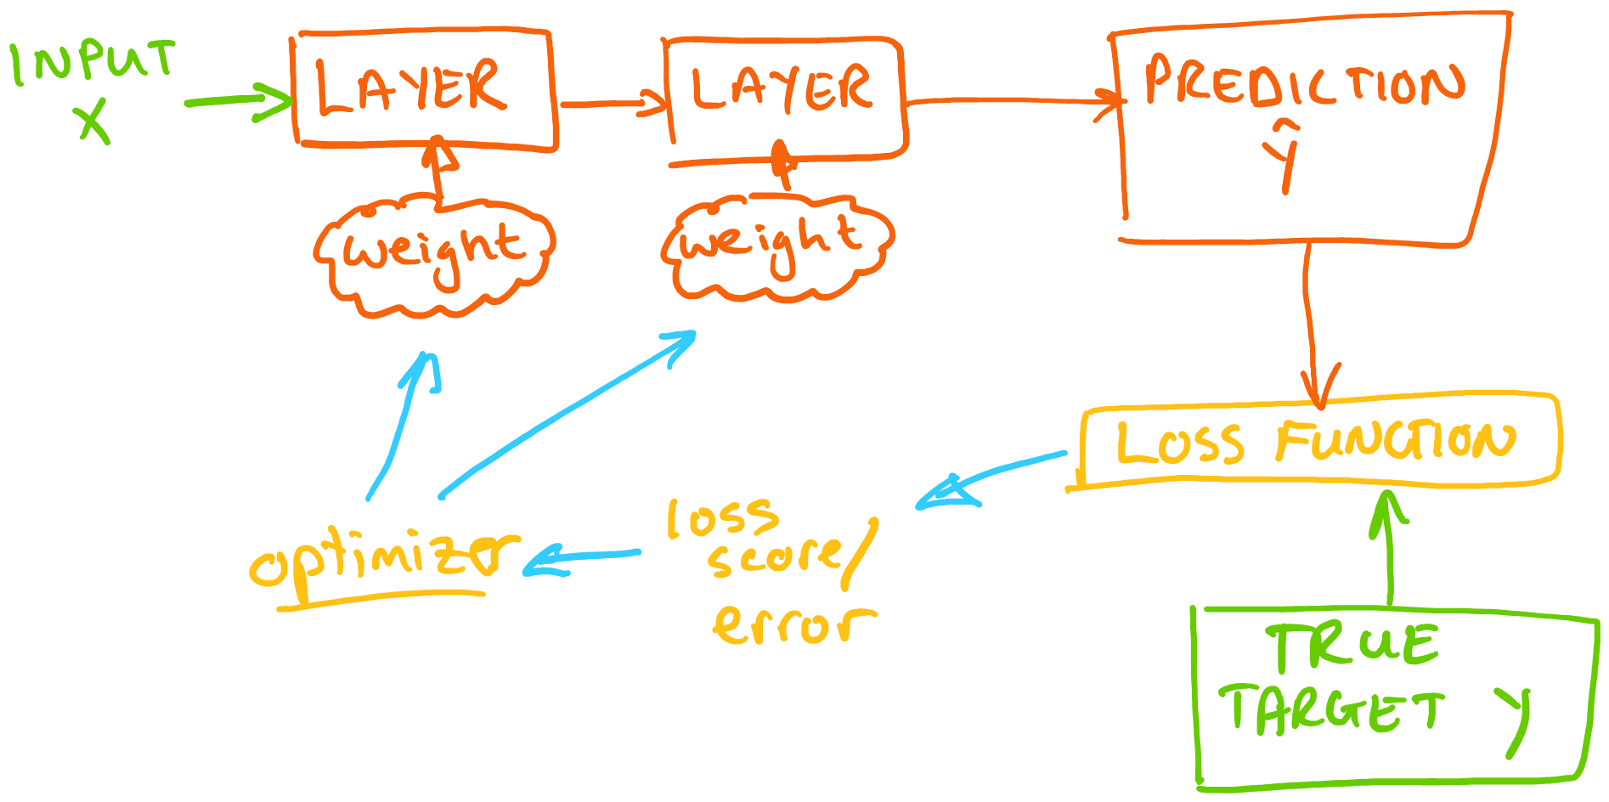
Y = f(X)
Forward propagation of input pattern
Calculate LOSS function
Back propagation: calculate derivatives of network weights

Slide 16
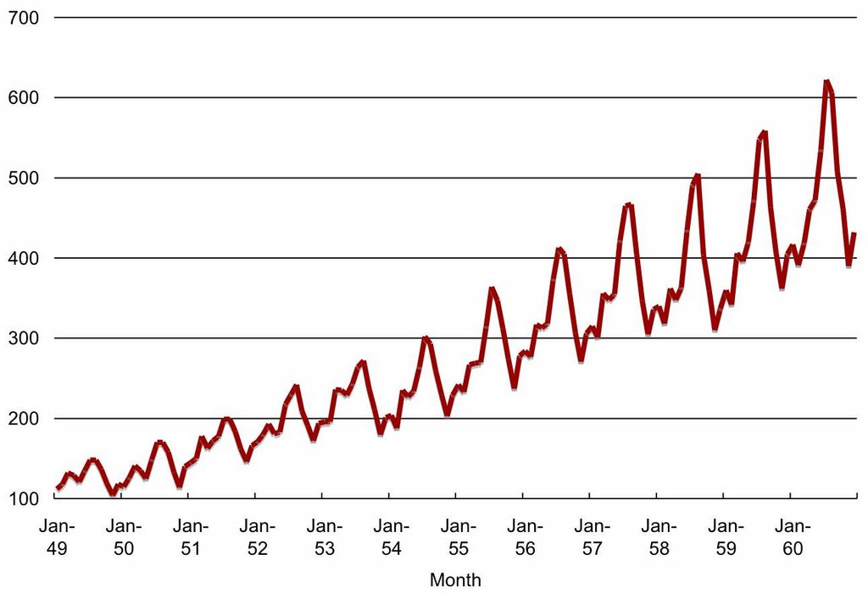
Time-series data
https://naadispeaks.wordpress.com/2016/12/20/time-series-forecasting-with-azure-ml/

Slide 17
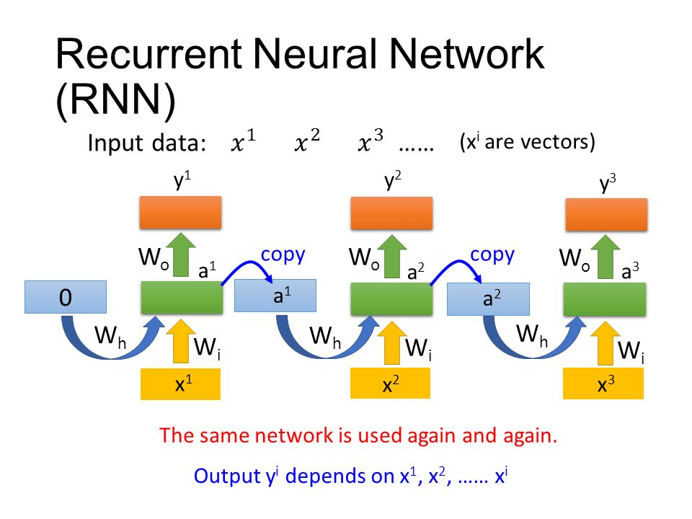
Hung-Yi Lee: https://slideplayer.com/slide/7478657/

Slide 18
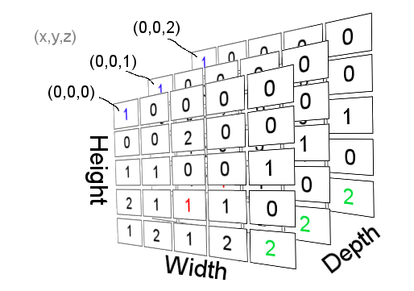
https://www.scirra.com/tutorials/307/arrays-for-beginners/page-5

Slide 19
https://arxiv.org/pdf/1511.03677.pdf

Slide 20
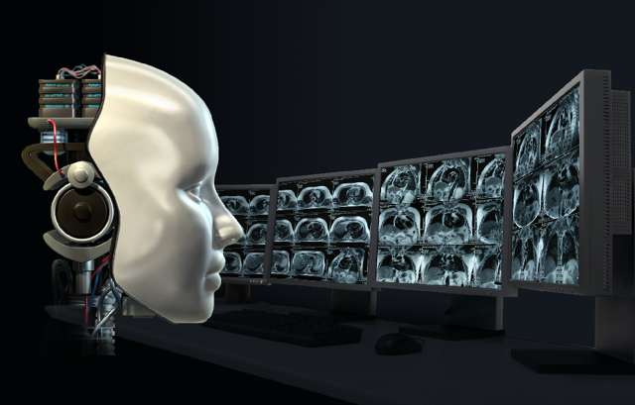
Computer vision
https://mse238blog.stanford.edu/2017/08/imunizr/ai-takes-on-radiology/

Slide 21
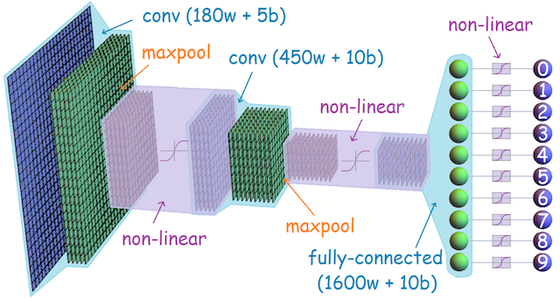
https://leonardoaraujosantos.gitbooks.io/artificial-inteligence/content/convolutional_neural_networks.html

Slide 22

https://cs231n.github.io/classification/

Slide 23
https://www.scirra.com/tutorials/307/arrays-for-beginners/page-5

Slide 24
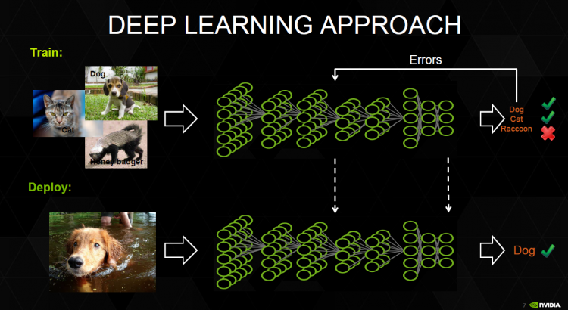

Slide 25
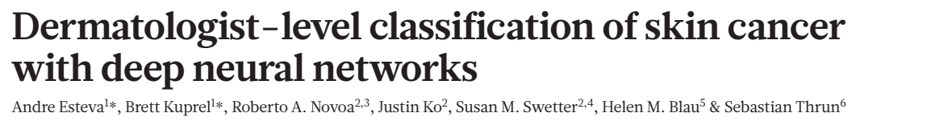

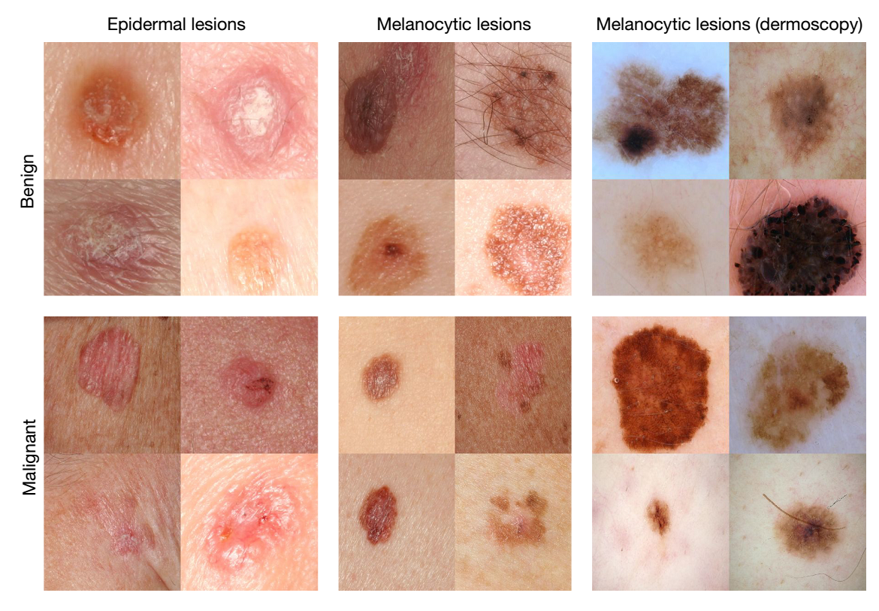
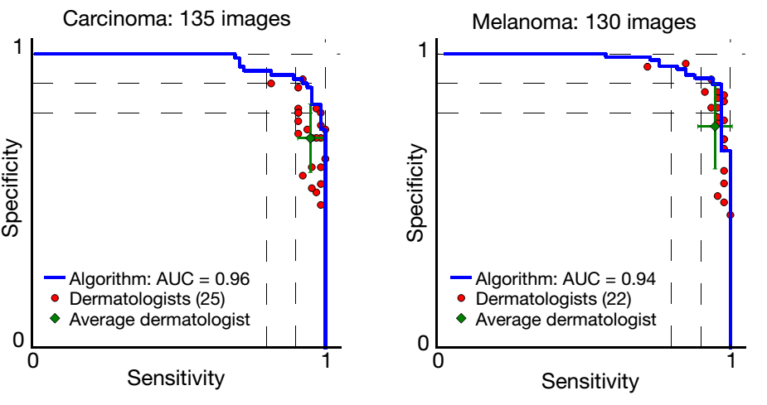
[Feb 2017]

Slide 26
In summary
Multiple (deep and complex) algorithms
Open-source programme languages include algorithms in modules
Python / R
Need to understand where the “bear traps” are
Neural networks are cool!

Slide 27
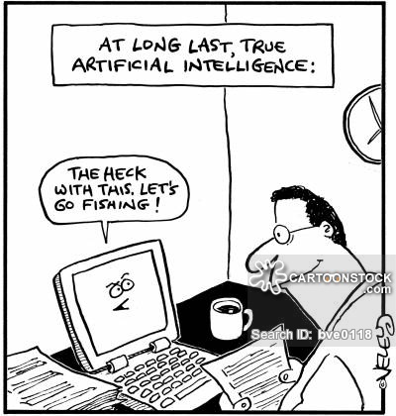

AI / deep learning systems will evolve to become really helpful (and indispensable?)
Require considerable effort and understanding to train
Sustained & long term investment in hard- & software systems needed
Need to train the humans to develop these systems
Welcome to the future

Slide 28
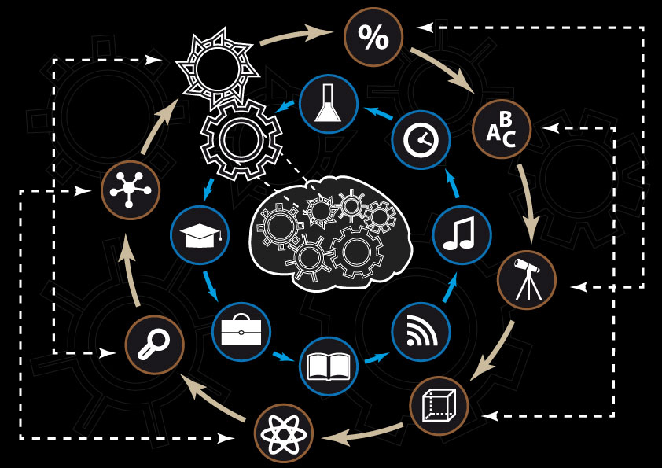

Welcome to the future
Computers doing things computers are good at
Humans doing things humans are good at
@mterblanche2 @GSTT_ICU
https://trystanowainhughes.wordpress.com/2015/05/10/ https://www.psfk.com/2015/04/cognitive-computing-explanation-understanding-ibm-watson.html

